Slide 1




SMART AMBULANCE DISPATCH AND ROUTE OPTIMIZATION
Advanced DSA-Based Emergency Healthcare Resource Allocation System
REVIEW 3
DSA-III PROJECT
Network Flow
Advanced DP
Max Flow / Dinic
Bitmask · Edit Distance
Matching
Approximation
Bipartite · Assignment
TSP · Dijkstra
🚑 Dispatch
🗺️ Routing
🏥 Allocation
Priority-driven ambulance assignment
Shortest + multi-stop optimization
Capacity-aware hospital & bed flow
👨‍⚕️ Matching
🔍 Search
Patient–doctor bipartite matching
KMP + fuzzy medical record search

Slide 2





What We Built
A fully integrated emergency healthcare resource allocation engine, covering the complete lifecycle from incident detection to treatment assignment. The pipeline below represents the end-to-end system flow implemented across all modules.
Emergency Request
Incident detected, patient details captured
Ambulance Assignment
Nearest suitable unit dispatched
Route Optimization
Shortest / multi-stop path computed
Hospital Selection
Availability + specialization constraints
Bed Allocation
Flow-based capacity assignment
👨‍⚕️ Doctor Assignment
🚨 Multiple Emergencies
Bipartite matching on specialization, availability, and workload
Concurrent prioritization and resource reallocation across incidents
🔍 Medical Record Search
📅 Patient Scheduling
KMP + Edit Distance for fast and fuzzy patient record retrieval
DP-based scheduling under resource constraints

Slide 3
System Architecture
The system is structured as a three-layer pipeline: structured inputs feed an algorithm engine, which produces actionable dispatch outputs. Each layer is modular and independently testable.
INPUT LAYER
OUTPUT LAYER
Emergency request ID
Patient details (age, condition)
GPS location coordinates
Required medical specialization
Available ambulances, beds, doctors
Assigned ambulance unit ID
Optimized route
Selected hospital with capacity status
Allocated bed number
Assigned doctor + specialization
Patient treatment schedule
ALGORITHM ENGINE
Dijkstra
Assignment / Matching
Bitmask DP
Shortest path routing
Ambulance + doctor pairing
Multi-stop route sets
Max Flow / Dinic
KMP / Edit Distance
TSP Approximation
Bed capacity allocation
Medical record search
Scalable large routing

Slide 4
Current Implementation Status
Module-level progress dashboard as of Review 2. Status labels: IMPLEMENTED = core logic complete; DEMO = runnable with simulated data; IN PROGRESS = under active development. Do not interpret any module as production-ready unless explicitly validated.
Module | Function | Algorithm
Ambulance Dispatch | Assign suitable ambulance to emergency | Assignment
Route Optimization | Shortest / optimized emergency routes | Dijkstra + Bitmask DP
Hospital Selection | Choose hospital by availability + constraints | Greedy + Flow
Bed Allocation | Allocate limited beds via flow model | Max Flow / Dinic
Doctor Assignment | Match patients with appropriate doctors | Bipartite Matching
Emergency Handling | Prioritize + allocate for multiple incidents | Priority Queue + DP
Medical Search | Fast + fuzzy patient record retrieval | KMP / Rabin-Karp + Edit Distance

Slide 5








DSA-III Algorithms Used
Nine distinct algorithms from the DSA-III curriculum are integrated across the system's modules. Each algorithm is mapped to a specific operational problem in the emergency dispatch pipeline.
Dijkstra
Problem: Ambulance routing
Role: Shortest path on weighted road graph; O((V+E) log V)
Assignment / Matching
Problem: Ambulance assignment
Role: Optimal unit-to-emergency pairing; Hungarian O(n³)
Bitmask DP
Problem: Multi-stop routing
Role: Optimize small route sets; O(2ⁿ · n)
Max Flow / Dinic
Problem: Bed allocation
Role: Capacity-aware allocation; O(V² · E)
Bipartite Matching
Problem: Doctor assignment
Role: Patient–doctor matching; O(V · E)
KMP / Rabin-Karp
Problem: Medical record search
Role: Fast exact pattern search; O(n + m)
Edit Distance (Wagner-Fischer DP)
Problem: Fuzzy search
Role: Handle spelling variation; O(m · n)
TSP Approximation
Problem: Large-scale routing
Role: Near-optimal scalable routing; O(n² log n)

Slide 6

Working Module: Emergency Dispatch Demo
SIMULATED DATA
The following example demonstrates the dispatch pipeline for a single critical emergency. All values are simulated and should be replaced with actual project output where available.
Emergency E102 — Input
Dispatch Output
Severity: Critical
Location: Patient Area A
Required: Cardiac specialization
Available Ambulances: A05, A07, A12
Nearest Hospital: H02 (Cardiac unit available)
Assigned Ambulance: A07
Route: Depot → Patient Area A → Hospital H02
Algorithm: Dijkstra (shortest path)
Multi-stop fallback: Bitmask DP / TSP Approximation
Dispatch A07
Compute Route
Extend to H02
For single-destination routing, Dijkstra computes the optimal path on the weighted road graph. When multiple pickup or drop-off stops are required, Bitmask DP (for small n) or TSP Approximation (for larger n) is applied to minimize total travel time across all waypoints.

Slide 7
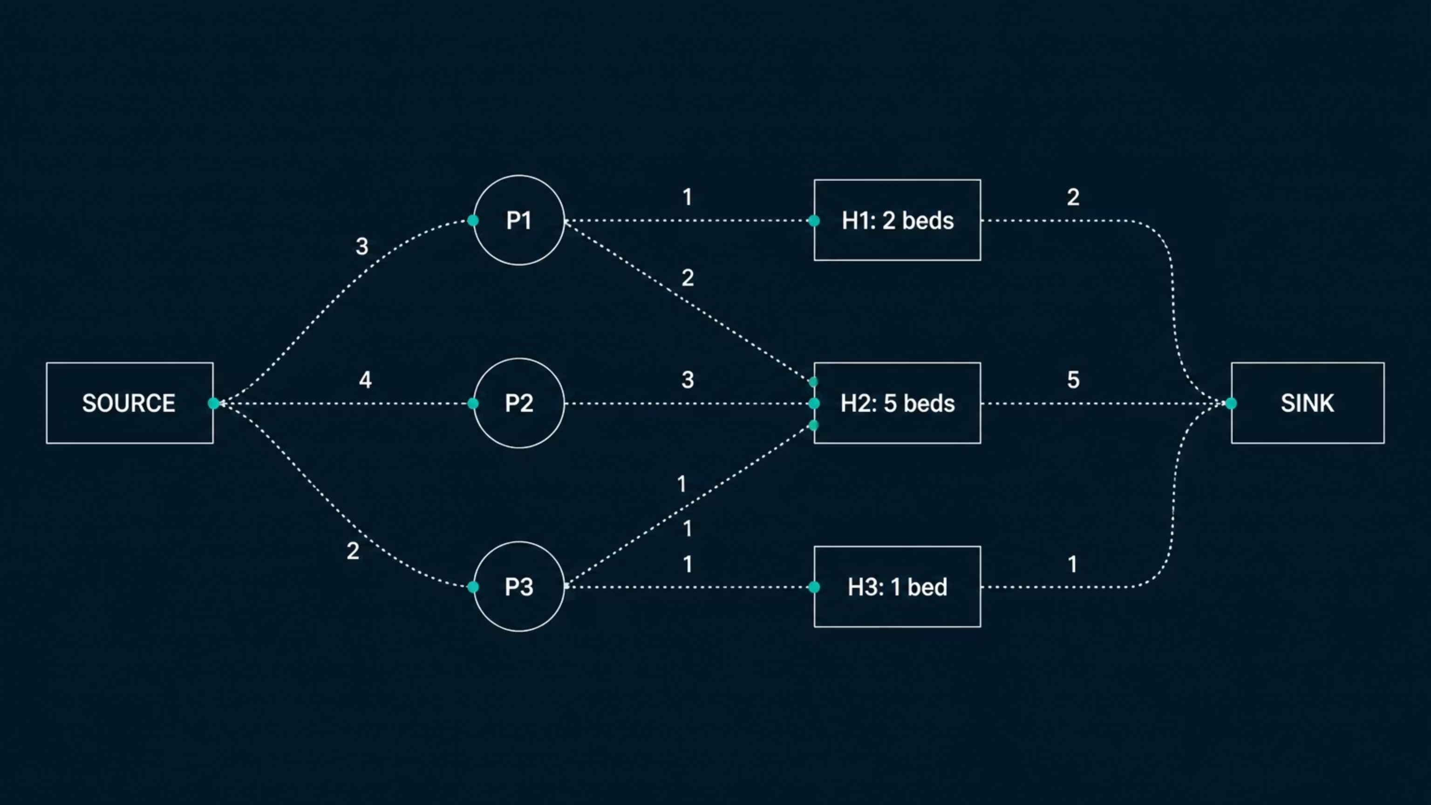
Working Module: Resource Allocation via Network Flow
SIMULATED DATA
Bed allocation is modeled as a maximum flow problem. Patients are sources, hospitals are intermediate nodes with capacity constraints, and the sink represents successful allocation. The Dinic algorithm ensures no hospital exceeds its available bed count.
Flow Network Structure
Simulated Hospital Capacities
SOURCE → PATIENTS → HOSPITALS → CAPACITY → SINK
Hospital H1 → 2 available beds
Hospital H2 → 5 available beds
Hospital H3 → 1 available bed
Source node connects to each patient with capacity 1
Each patient connects to eligible hospitals
Hospital nodes have capacity = available beds
Hospital connects to sink with bed-count capacity
Expected Flow Output
Algorithm: Max Flow / Dinic — O(V² · E)
Key constraint: Allocation cannot exceed hospital capacity at any node.
Max flow = min(total patients, total beds)
Each patient allocated to exactly one hospital
No hospital over-allocated beyond capacity
Result: To be validated

Slide 8
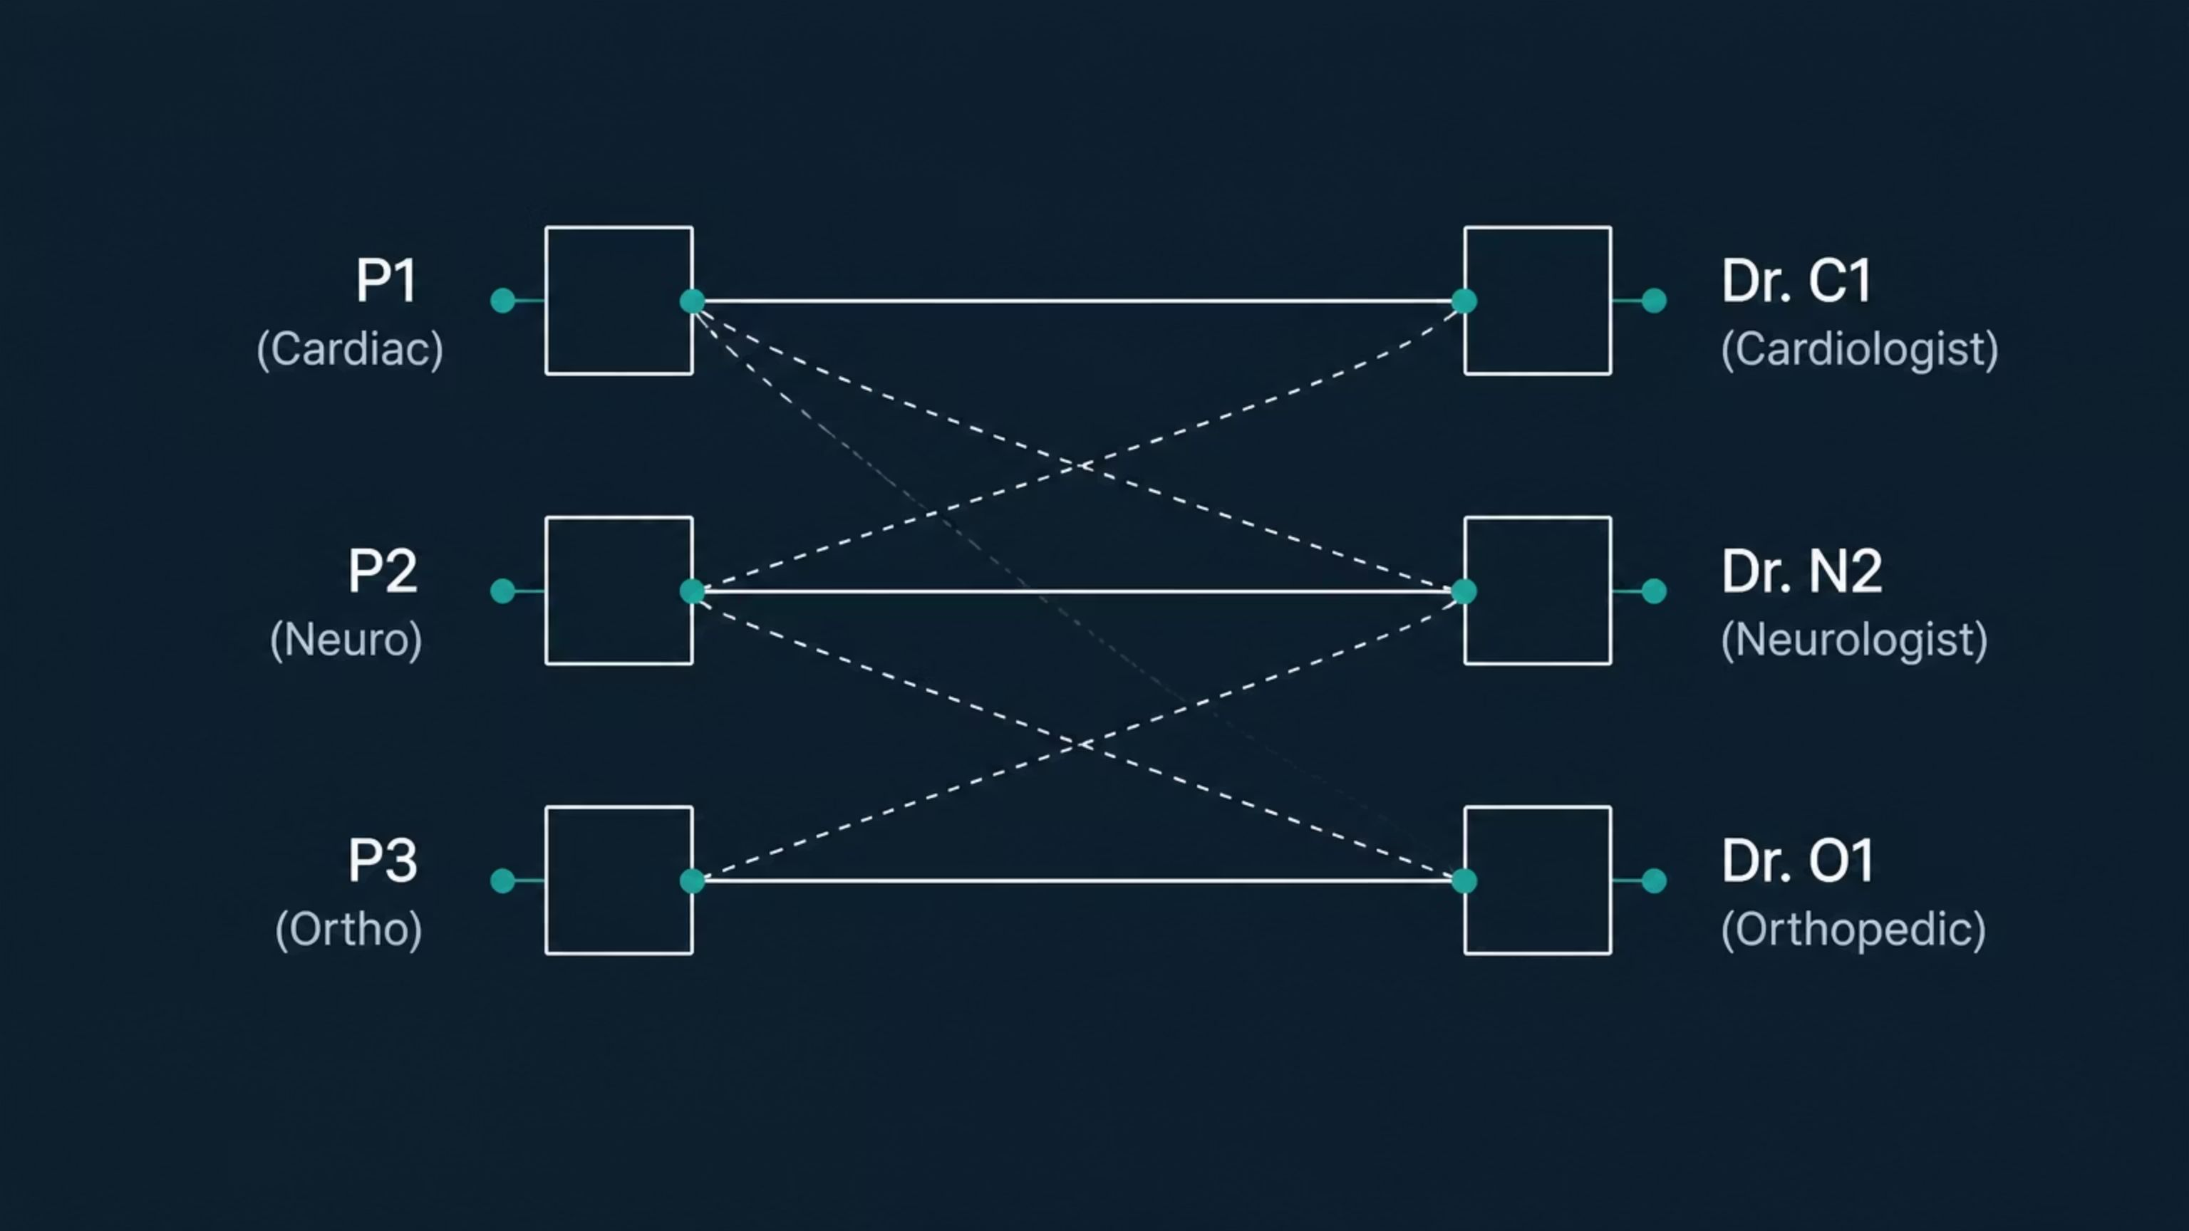
Working Module: Patient–Doctor Bipartite Matching
SIMULATED DATA
Doctor assignment is modeled as a bipartite matching problem. The left partition contains patients (with required specialization), and the right partition contains available doctors. Edges exist where a doctor's specialization, availability, and workload permit assignment.
Matching Criteria
Simulated Matching Output
Specialization: Doctor must match required field
Availability: Doctor must not be in active case
Priority: Critical patients matched first
Workload: Load-balanced across available doctors
P1 (Cardiac arrest) → Cardiologist Dr. C1
P2 (Head trauma) → Neurologist Dr. N2
P3 (Fracture) → Orthopedic Specialist Dr. O1
Algorithm: Bipartite Matching / Hungarian Assignment
Complexity: O(V · E)
Unmatched patients (no available specialist) are queued and re-evaluated on next scheduling cycle.
Result: To be validated

Slide 9

Medical Record Search: String Algorithms + DP
The medical record search module demonstrates two complementary string-processing techniques: exact pattern matching via KMP / Rabin-Karp, and approximate (fuzzy) matching via Edit Distance (Wagner-Fischer DP). Together they handle both precise queries and real-world spelling errors in clinical notes.
Exact Search — KMP / Rabin-Karp
Fuzzy Search — Edit Distance (Wagner-Fischer DP)
Query: "cardiac arrest"
Misspelled query: "cardic" → corrected to "cardiac"
Scans patient records, emergency descriptions, and medical notes
KMP builds failure function in O(m), then scans in O(n)
Rabin-Karp uses rolling hash for multi-pattern search
Returns all records containing exact match
Computes minimum edit operations (insert, delete, substitute)
Wagner-Fischer fills an (m+1)×(n+1) DP table
Matches returned if edit distance ≤ threshold
Handles real-world clinical note spelling variation
Complexity: O(n + m) per document
Complexity: O(m · n) per candidate string
Input: Patient Record
KMP Exact Match
Free-text clinical notes, emergency descriptions, diagnosis fields
Failure function preprocessed on pattern; linear scan on text corpus
Edit Distance Fuzzy
Output: Ranked Results
DP table computed for each candidate; threshold-filtered results returned
Exact matches ranked first; fuzzy matches ranked by edit distance score
This module demonstrates how String Algorithms (KMP, Rabin-Karp) and Advanced DP (Wagner-Fischer Edit Distance) are applied directly to the healthcare domain — not just as theoretical constructs.

Slide 10

Handling Multiple Concurrent Emergencies
SIMULATED DATA
The most complex scenario: three simultaneous emergencies competing for a constrained resource pool. The system must jointly optimize dispatch, bed allocation, and doctor assignment using a combination of Network Flow, Assignment, and DP algorithms.
Concurrent Emergencies
Algorithm Roles in This Scenario
E1 — Cardiac arrest (Critical, Priority 10)
E2 — Road accident (High, Priority 8)
E3 — Surgical emergency (Medium, Priority 5)
Priority Queue: Orders E1 → E2 → E3 for processing
Assignment: Maps each emergency to best available ambulance
Network Flow (Dinic): Allocates 2 ICU beds across 3 competing patients
Bipartite Matching: Assigns the single surgeon to highest-priority surgical case
DP Scheduler: Maximizes total priority served under all constraints jointly
Limited Resource Pool
3 Ambulances available
2 ICU Beds available
1 Surgeon available
Result: To be validated against actual project output.
Priority Queue
Routing
Three emergencies enter queue
Dijkstra finds nearest hospital
Resource Allocation
Assignment
Map each case to ambulance
Dinic & matching assign beds and surgeon
Network Flow
Assignment
Bed allocation under capacity — Dinic O(V²·E)
Ambulance-to-emergency mapping — Hungarian O(n³)
DP Scheduler
Bipartite Match
Joint optimization across all constraints — O(2ⁿ·n)
Surgeon assignment to critical case — O(V·E)

